Slide 1

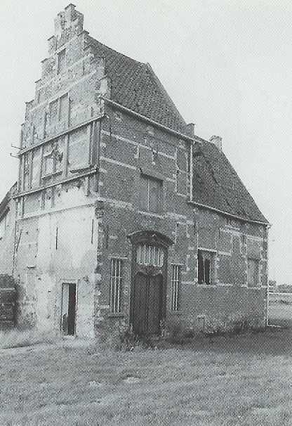




60min
n-tier
hexagonal
onion
Code-Show
Theoretical
Introduction
ArchitectureTrack

Slide 2




Menu
Architecture Kick Off
Dependency Inversion
N-tier
Ports-and-Adapters
Hexagonal
Onion

Slide 3



Architecture Kick Off
Good architecture makes it easy to do the right thing and hard to do the wrong thing
Notes:
https://github.com/itenium-be/Architecture-KickOff
Where we talked about becoming an Architect and what Architecture is.

Slide 4

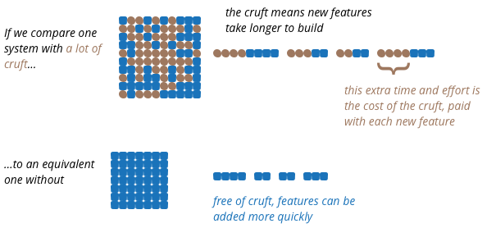
Architecture Kick Off
Make sure you have the right abstractions
… I mean… Architecture!
Notes:
Martin Fowler:
https://martinfowler.com/bliki/PresentationDomainDataLayering.html

Slide 5


Dependency Inversion
High-level modules should not depend on low-level modules. Both should depend on abstractions.
// A high level component
class SaveButton {
click() {
// Depends on a low-level
// detail (implementation)
File.Save(path, content);
}
}
Notes:
A UI Component now depends on the FileSystem!

Slide 6

Dependency Inversion
Invert the dependency between
UI and FileSystem
// Now the UI Component
class SaveButton {
IStorage storage;
click() {
// Depends on an abstraction
// Which we can switch out
// (Cloud, Mock, ...)
storage.save(content);
}
}

Slide 7

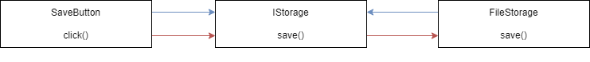

Dependency Inversion
The high level module and the low-level implementation depend on an abstraction
Dependency Flow
Control Flow

Slide 8

Dependency Inversion
Architecture is all about managing complexity dependencies
Split by responsibility or concern
Achieve low coupling
Easier Testing
Achieve modularity
Ability to scale
Achieve encapsulation
Reduce mental overload
Dependency-Inverted Architectures then?

Slide 9

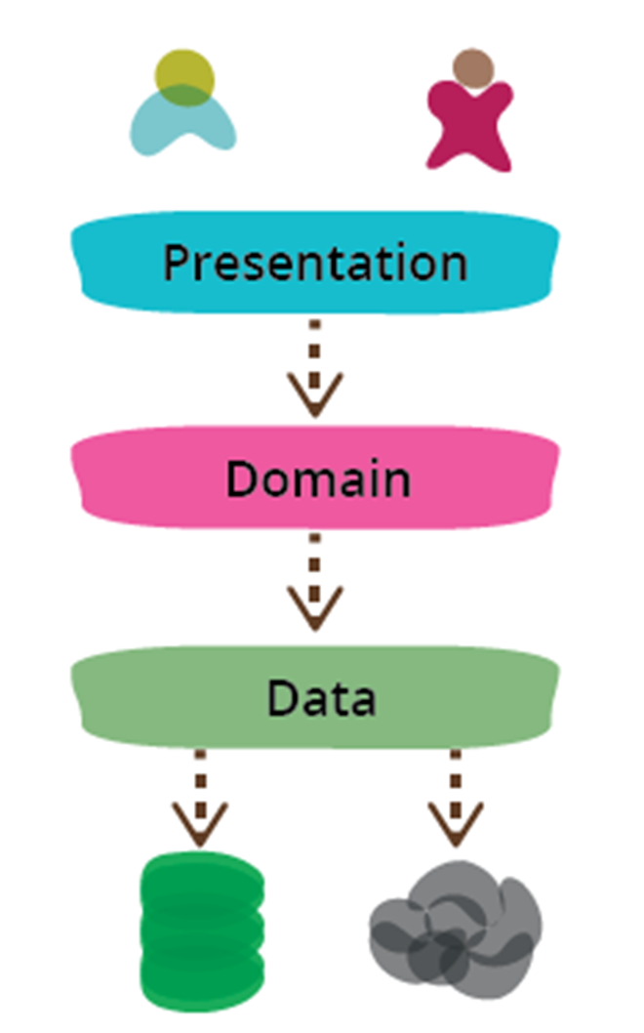

3-Tier
a timeless classic
Reduce scope of attention
Substitute a layer
Replacing the database? Not happening…
But you can have a Web UI and a Mobile UI
Or even an API and/or CLI
Easier testing
Layers are natural seams
UI == hard to test | BL == easy to test
Each tier can be… Multi layered!
Notes:
UI hard to test:
Minimize logic there and put it all in the BL.
Or use an MVC, MVVP style of design in the presentation layer.
Multi layered tier:
The Domain Tier could contain
Validation Layer
Processing Layer
Mapping Layer

Slide 10
Multitier
Almost no learning curve
Easy and cheap to implement
For simple, small and medium sized applications
Good starting point for larger applications
When the domain, scope or architectural requirements are not yet (fully) known
Easy to migrate from
But… NOT a good top tier architecture
Notes:
Architectural Requirements: The itilites: scalability, reliability, security, …

Slide 11
Multitier
Not a good fit for top level architecture of larger applications?
MicroServices: What architecture are you using for each micro service?
Yup…, that’s right!
Typically a Monolith
Physical Tiers: deploy on different machines / vms
Logical Layers: same machine / process
Tiers communicate with REST / Remoting / …
Notes:
Tiers: Watch out for performance (network traffic or process switching)
Layers: Watch out for mapping, this hinders maintainability and also impacts performance

Slide 12
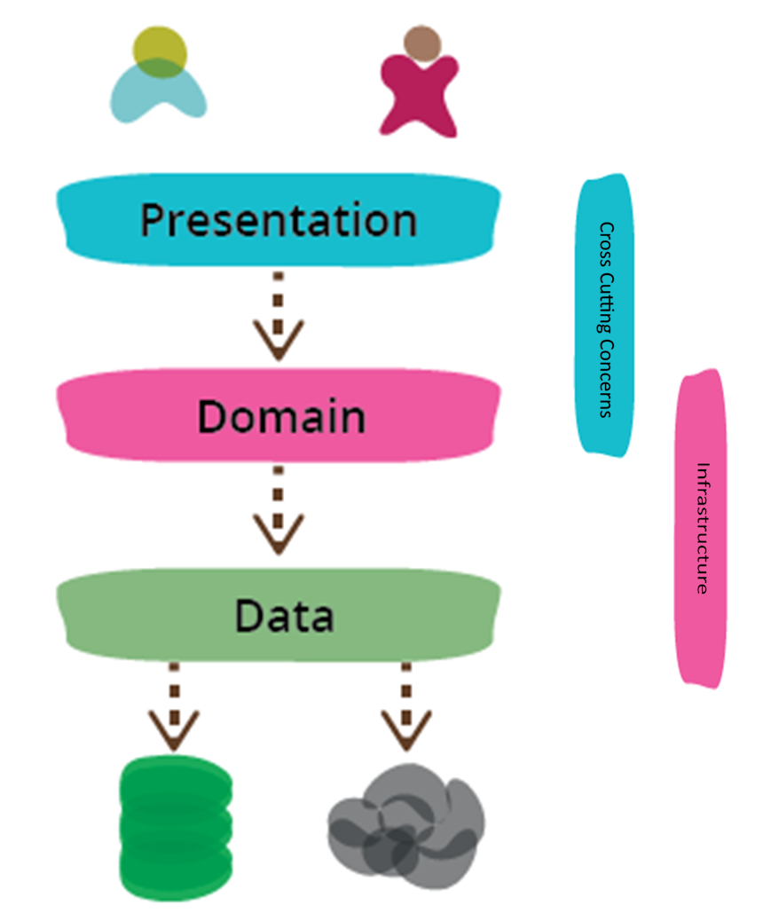
Multitier
Limit which layers talk to each other
What about cross cutting concerns?
Note those Photoshop skillz!

Slide 13
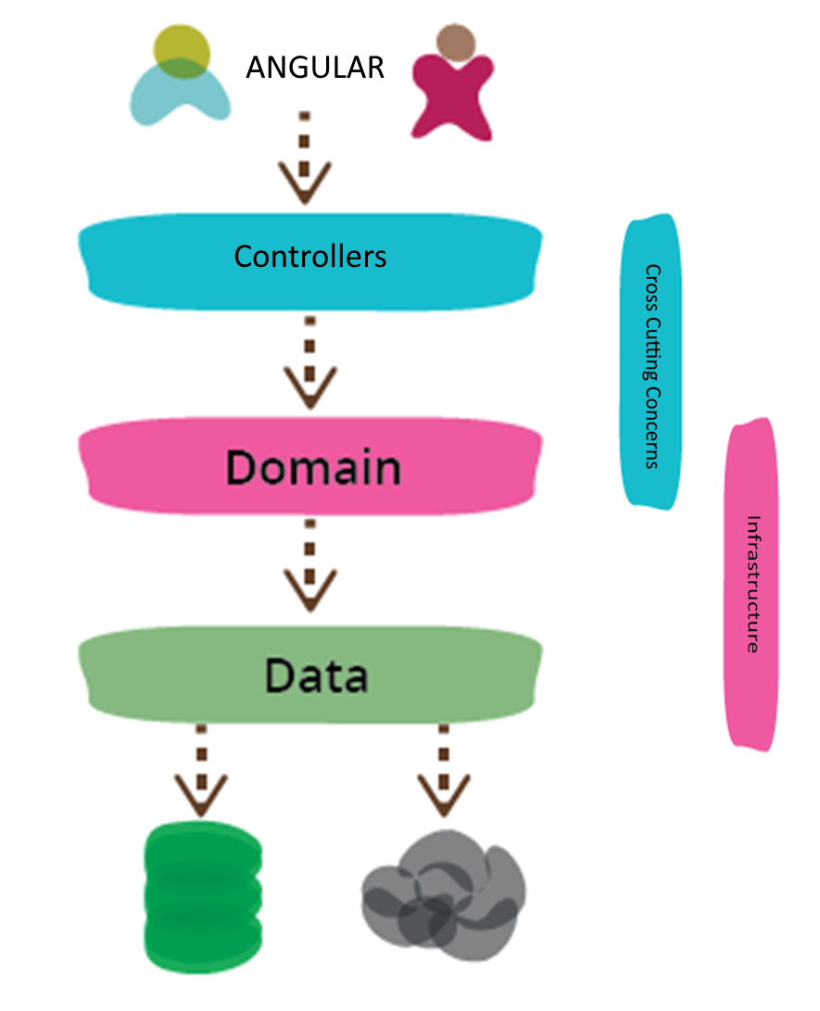
Multitier
Desktop Apps are so 1990! 😢
Notes:
Controllers: WebApi or Spring

Slide 14
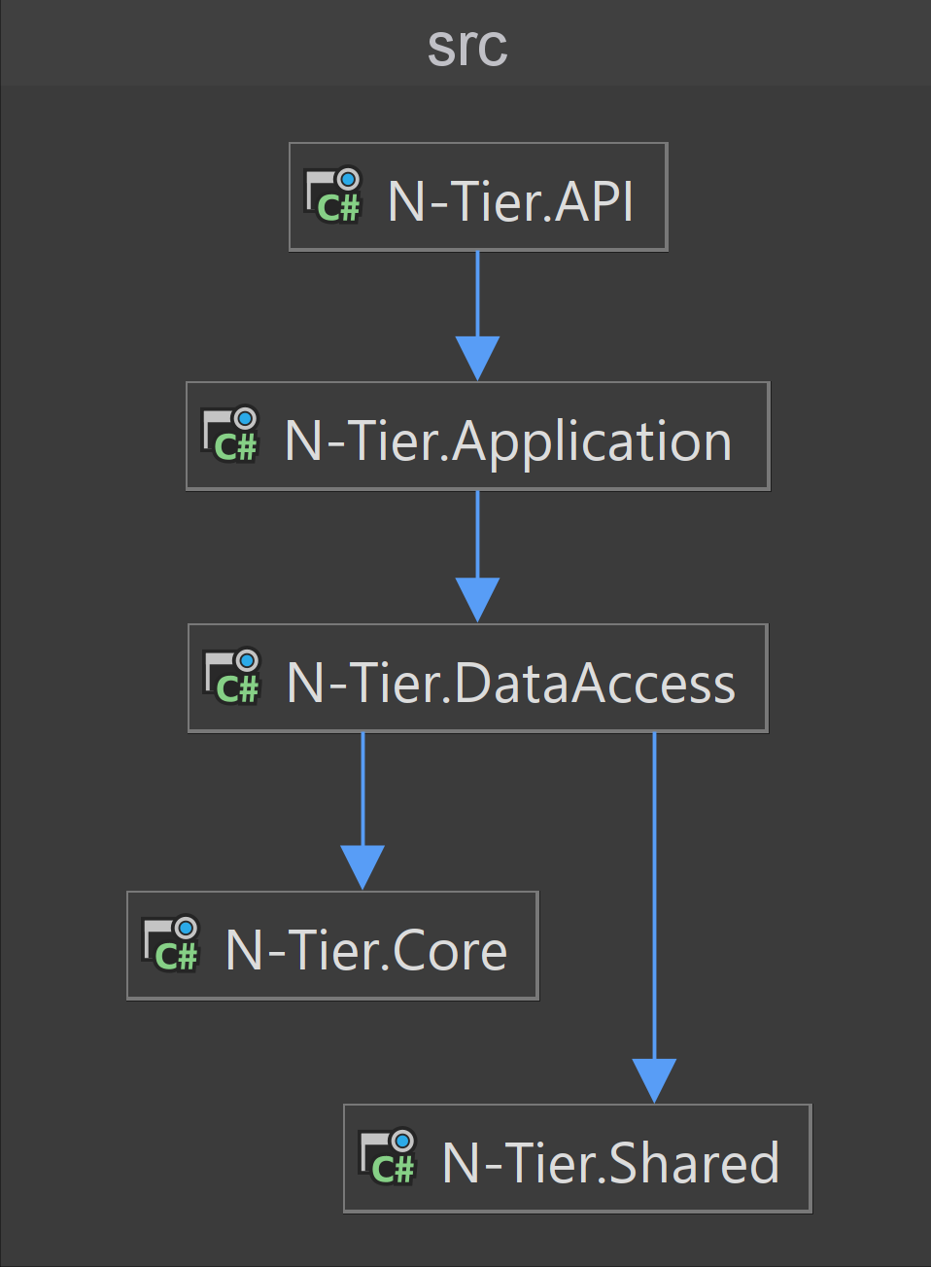
Multitier
Example App
Maybe it’s not that easy?
… I hate the implementation… 😊
Notes:
https://github.com/nuyonu/N-Tier-Architecture

Slide 15
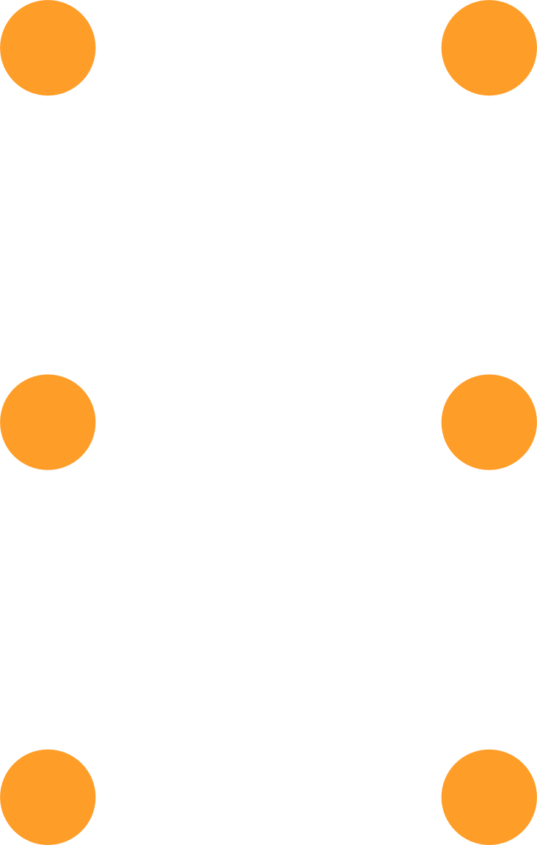


Break?

Slide 16
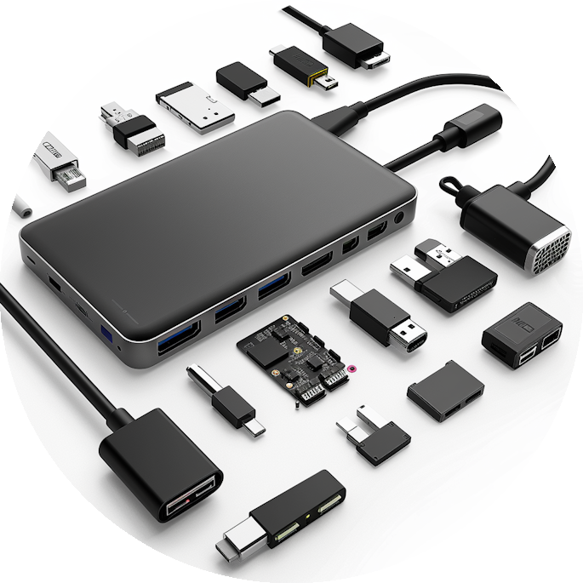
Ports and Adapters
Domain-Centered Architecture
Dependency flow towards the center
Domain has no dependencies
Ports: interfaces for core communication
Adapters: port implementations
Incoming Ports == Primary / Driving Adapters
Entry points to the application (Controllers, GUI event handlers)
Convert external requests to core logic format
Outgoing Ports == Secondary / Driven Adapters
Database interaction, 3rd Party APIs
Core dependencies (Mailing, Payments)
Notes:
Inner layer defines interfaces, outer layers implement them

Slide 17
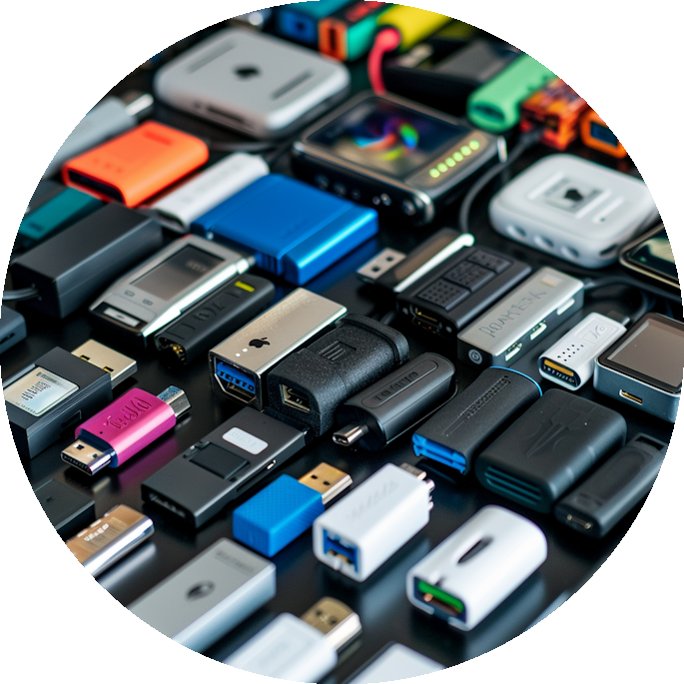
Ports and Adapters
Additional complexity
Don’t use for small projects!
Learning curve
Not everyone knows what it actually means
Increased boilerplate
More layers and interfaces
Consider selective adoption for smaller projects

Slide 18
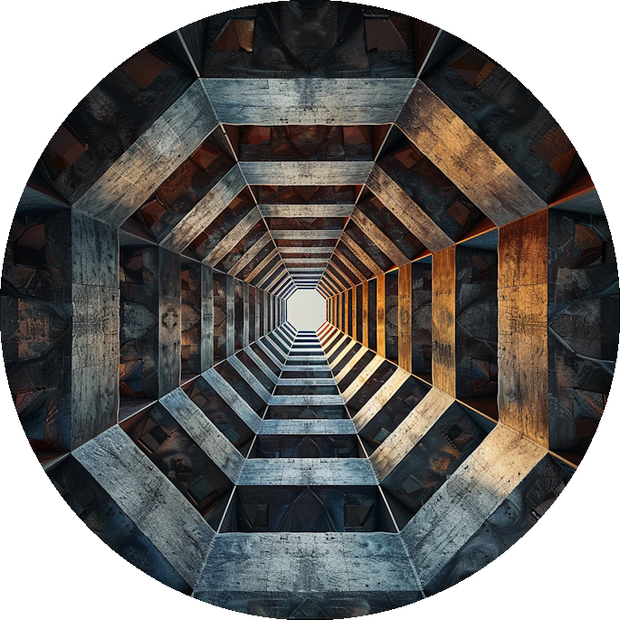
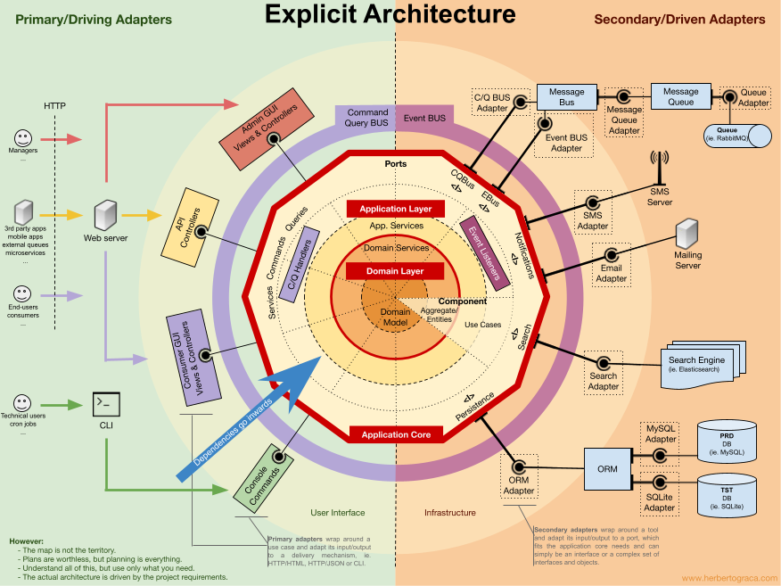
Hexagonal Architecture
A metaphor for Ports-and-Adapters
Notes:
From:
https://herbertograca.com/2017/11/16/explicit-architecture-01-ddd-hexagonal-onion-clean-cqrs-how-i-put-it-all-together/

Slide 19
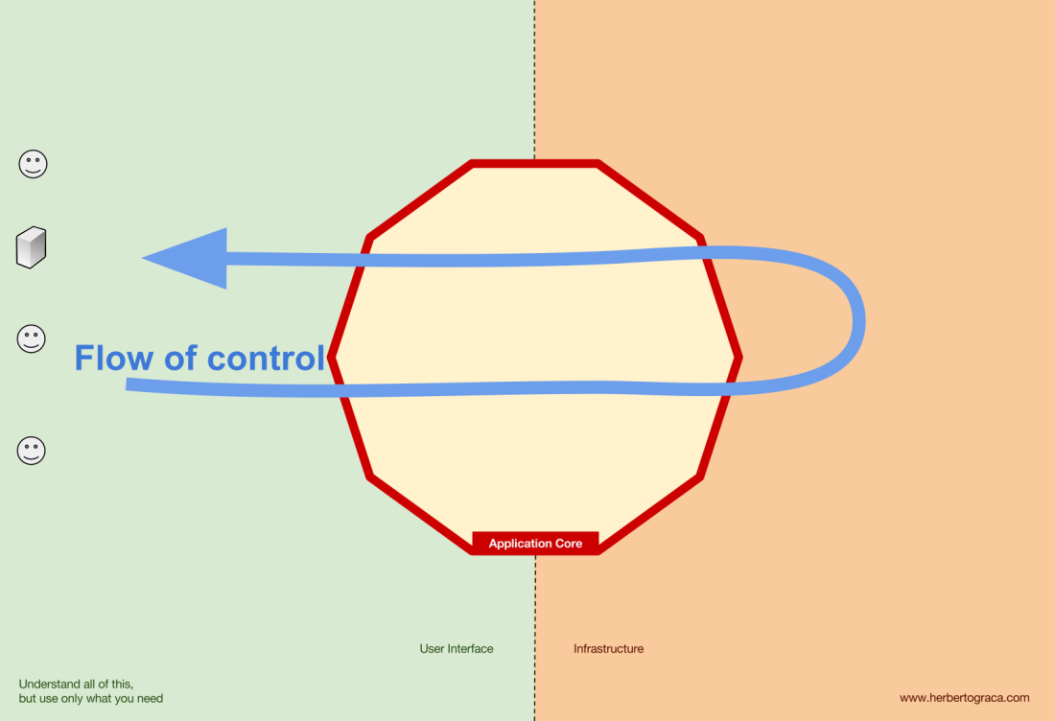
Hexagonal
Notes:
Left: our users: they use the user interface(s)
Flow of control goes inside the Application Core
Application Core: is what makes the magic happen
Right: The infrastructure
Our databases, 3rd party APIs

Slide 20
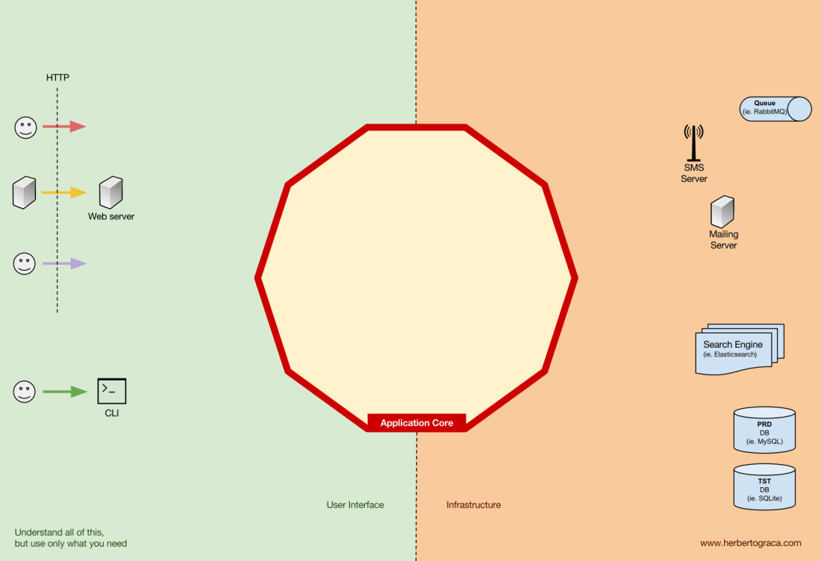
Hexagonal
Notes:
Left: user TELL our application to do something (Primary / Driving Adapters)
Right: our application TELLS the database to do something (Secondary / Driven Adapters)

Slide 21
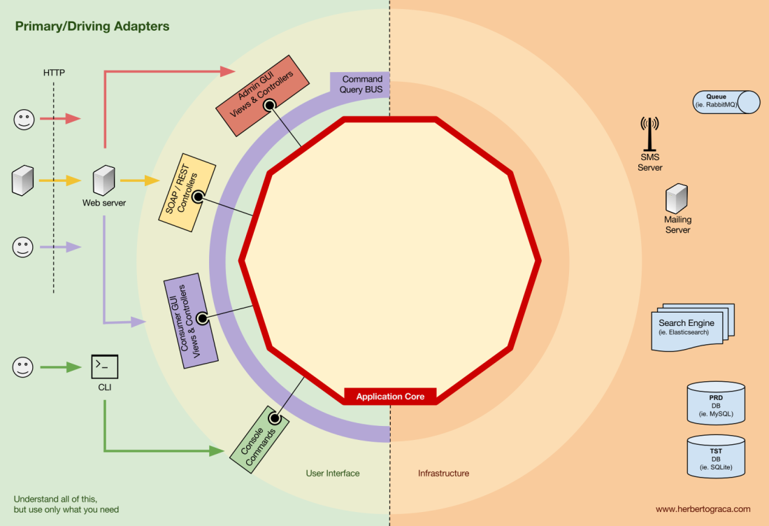
Hexagonal
Notes:
Left: Primary Adapters
The Application Core defines Ports == Interfaces (and maybe DTOs) – Services, Repositories, …
Which are implemented OUTSIDE the Application Core (ex: Controllers)

Slide 22
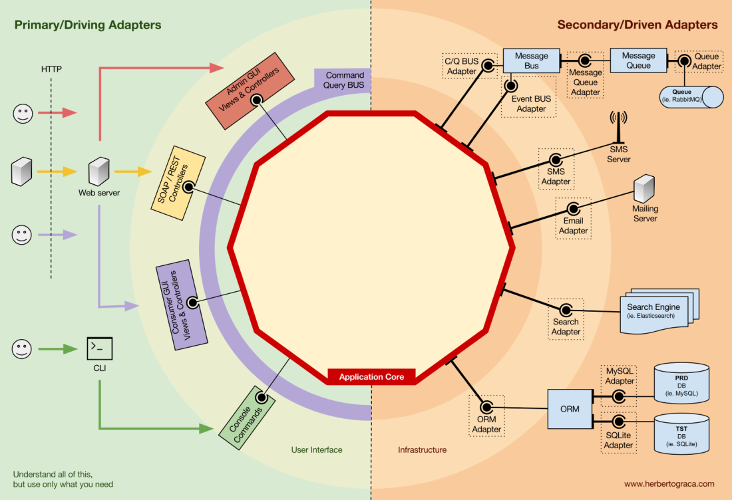
Hexagonal
Notes:
Right: Secondary Adapters
Adapters to send SMS, Emails, Storage, Payment, …

Slide 23
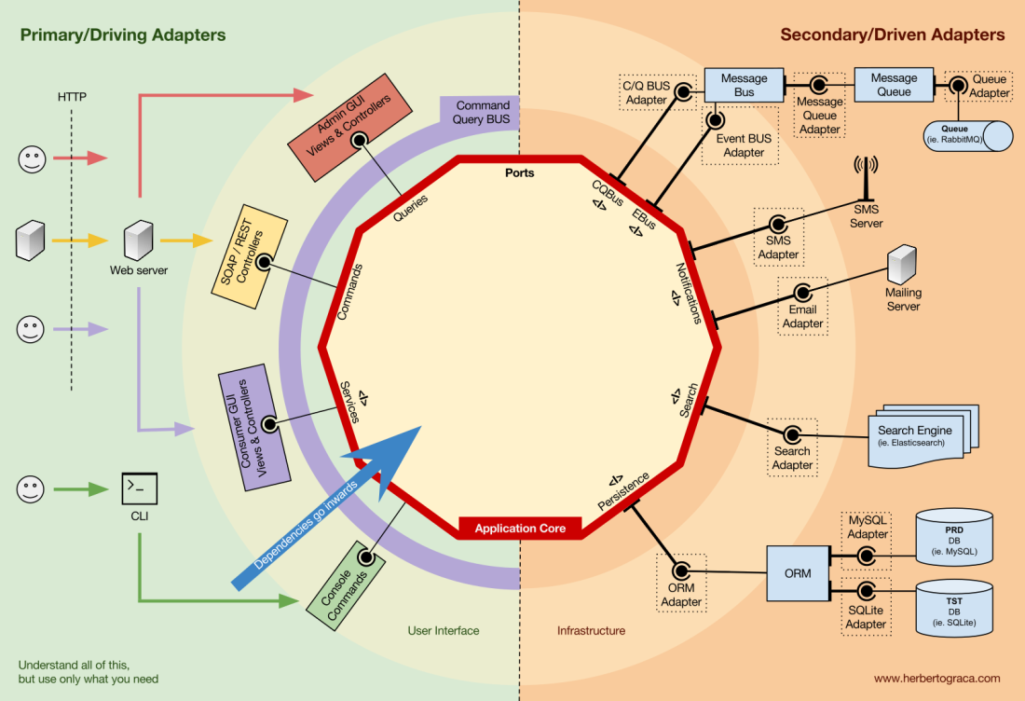
Hexagonal
Notes:
Dependency Inversion
The Application Core defines the Ports / Interfaces
User Interface and Infrastructure Layer implements the interfaces

Slide 24
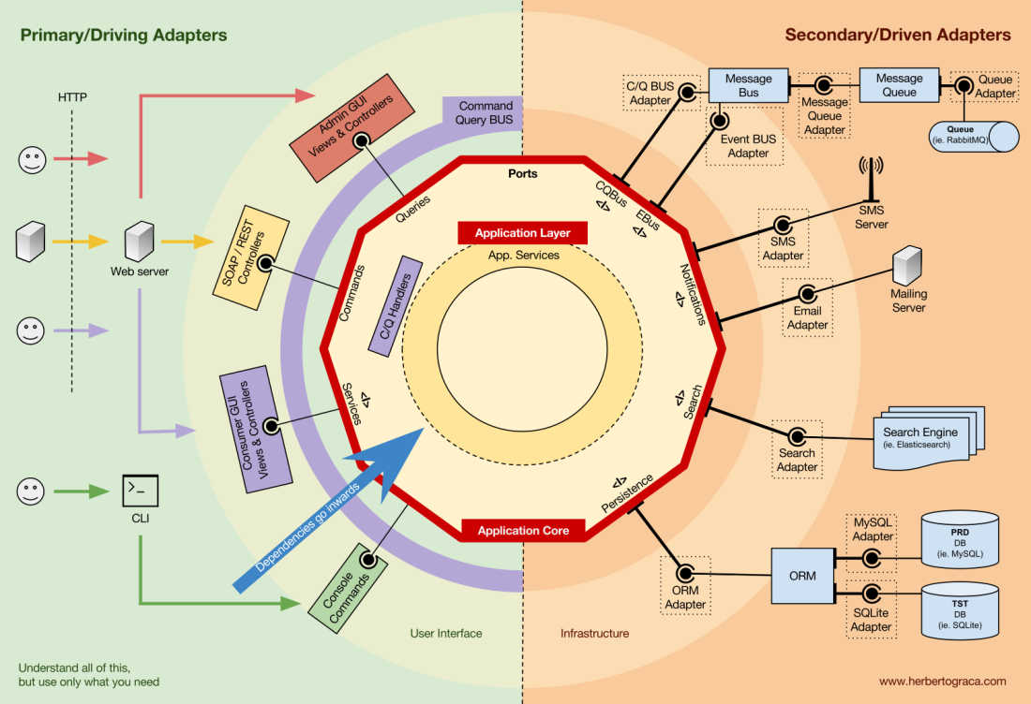
Hexagonal
Notes:
Application Layer
Application Interfaces/Services (UseCases, Business Processes)
ORM Interfaces
Repository Calls
Perform Business Logic
Command/Query Handlers → Implement Logic or Call a Service
Trigger Application Events, which trigger UseCase Side Effects
Emailing
Push Notifications
Start another UseCase

Slide 25
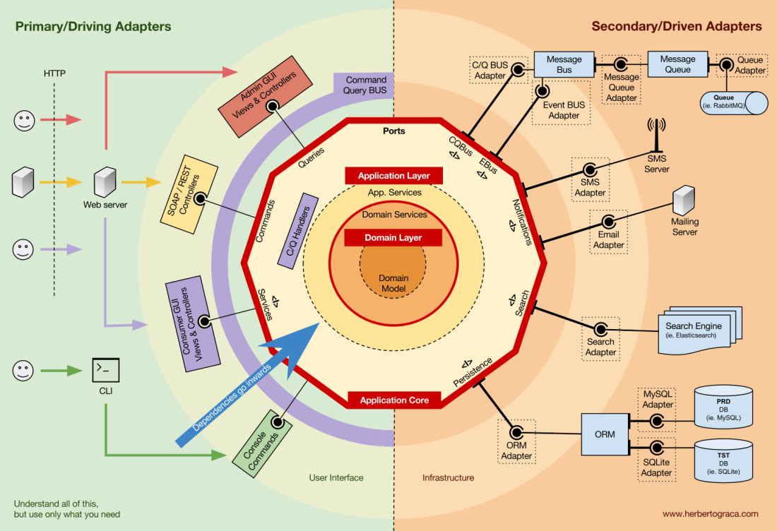
Hexagonal
Notes:
Domain Layer:
Domain Services: (optional)
Logic that spans multiple Domain Models
That can be used my multiple Application Services
Domain Models:
Data & Logic
Entities, Value Objects, Enums
Maybe Domain Events (Maybe for Event Sourcing)

Slide 26
Hexagonal Architecture
Hexagonal-Architecture-Acerola
Notes:
https://github.com/ivanpaulovich/hexagonal-architecture-acerola

Slide 27

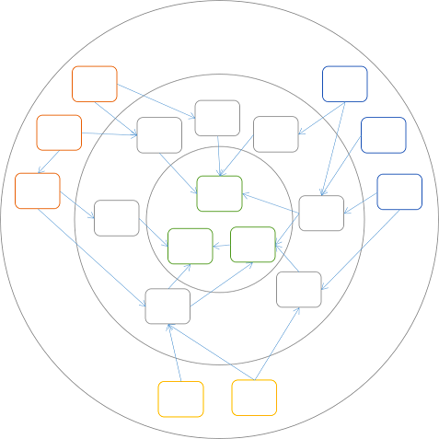
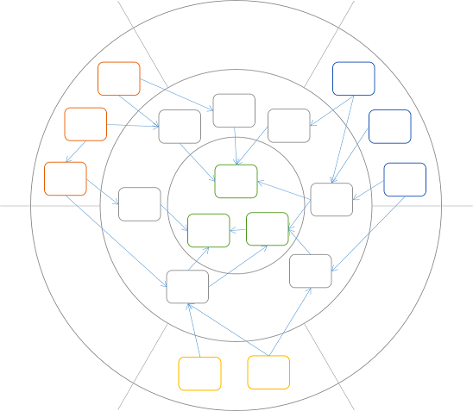
Onion Architecture
It’s pretty much exactly the same
Onion
Hexagonal
Notes:
It’s all the same
https://blog.ploeh.dk/2013/12/03/layers-onions-ports-adapters-its-all-the-same/
Onion:
Emphasizes on strict layering with dependencies pointing inward

Slide 28


So… Which One?
It Depends
Notes:
Personal Preference
The Team
The Project

Slide 29

Questions?

Slide 30



THANK YOU!

Slide 31








Our Socials
@itenium
@itenium_be
itenium
itenium-be
itenium.be
@itenium
itenium.be

